Slide 1

Bangladesh Army University of Science and Technology, Saidpur
Department of Computer Science and Engineering
Course Code: CSE 4140
Course Title: Machine Learning Sessional
Topic: Parkinsons Disease Detection
Date: 02-12-25
Presented By:
Md. Labib Ahsan
ID: 220201019
Presented To:
Engr. Rohul Amin
Lecturer, CSE, BAUST
Nadim Reza
Lecturer, CSE, BAUST

Slide 2
Introduction
Parkinson’s disease affects motor functions.
Early detection helps clinical decisions.
Machine Learning assists in identifying patterns in vocal biomarkers.

Slide 3
Objectives
• Perform exploratory data analysis.
• Train multiple ML models.
• Compare performance metrics.
• Identify the best performing classifier.

Slide 4
Dataset Description
• Dataset: parkinsons.csv
• 195 samples, 24 columns.
This dataset includes features like Fo, Fhi, Flo, jitter, shimmer, NHR, HNR, RPDE, DFA, spread1, spread2, D2, and PPE.

Slide 5
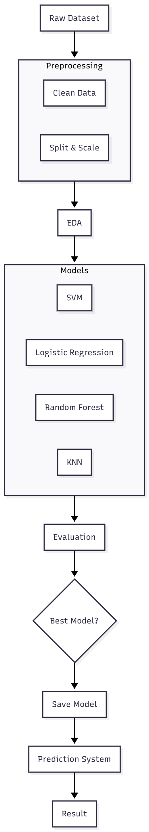
Methodology
fig.1: methodology

Slide 6
Exploratory Data Analysis
• Calculated mean, variance, skewness.
• Wide variation in frequency-based features.

Slide 7
Data Preprocessing
• Removed non-numeric columns.
• Train-test split (80/20).
• Standardized features using StandardScaler.

Slide 8
Models Used
• SVM
• Logistic Regression
• Random Forest Classifier
• KNN

Slide 9
Model Training
Load and clean dataset.
Split into train/test sets.
Scale numeric features.
Train models and evaluate.

Slide 10
Model Comparison
Table.1: Model Comparison
Model | Accuracy | Precision | Recall | F1-Score
SVM (RBF Kernel) | 0.8974 | 0.89 | 1.00 | 0.94
Logistic Regression | 0.8974 | 0.89 | 1.00 | 0.94
Random Forest | 0.9487 | 0.94 | 1.00 | 0.97
K-Nearest Neighbors | 0.9487 | 0.94 | 1.00 | 0.97

Slide 11
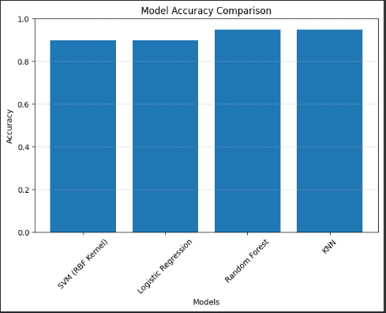
Results – Accuracy Comparison
• SVM: 0.897
• Logistic Regression: 0.897
• Random Forest: 0.949
• KNN: 0.949
fig.2: model comparison

Slide 12
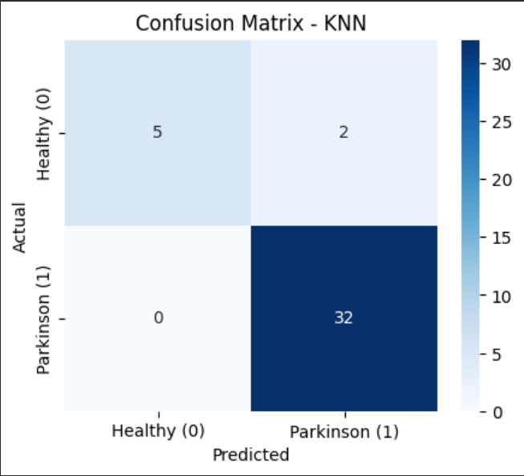
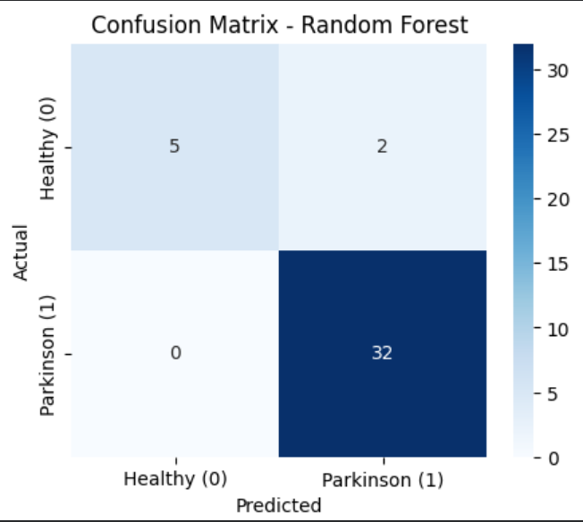
Confusion Matrices
• Random Forest & KNN performed best.
• Highest true positive rate for status=1.
fig.3: Confusion matrix for KNN
fig.4: Confusion Matrix for Random Forest

Slide 13
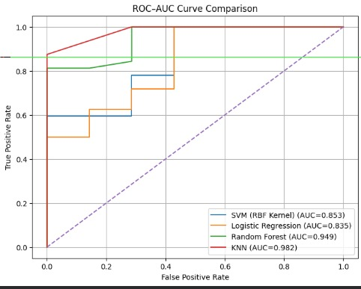
ROC–AUC Comparison
• Random Forest & KNN showed strongest AUC.
• SVM & Logistic Regression performed comparably.
fig.5: ROC-AUC Curve

Slide 14
User Input Prediction System
• Saved scaler & best model
• User enters 22 feature values.
• Model returns Parkinson’s / No Parkinson’s.

Slide 15
Conclusion
• ML models can reliably detect Parkinson’s disease.
• Random Forest produced the best results.
• Demonstrates potential for medical decision support.

